Slide 1

Spending, Saving & Borrowing

Slide 2
Why do people spend and save?
Why do some people spend or save more than others?
  Disposable income
Exercise: Factors that affect consumer expenditure and saving

Slide 3

In which country do people save most money? Why?

Slide 4
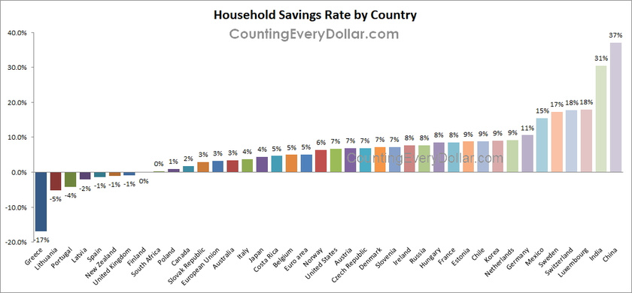

Slide 5
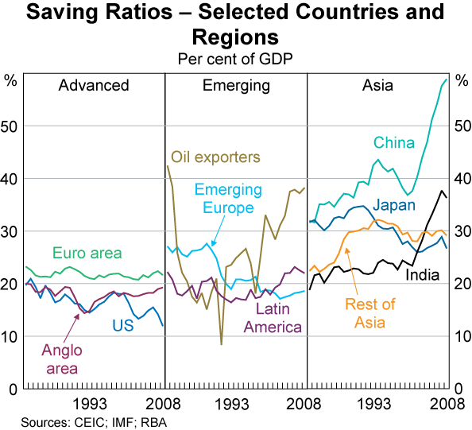

Slide 6
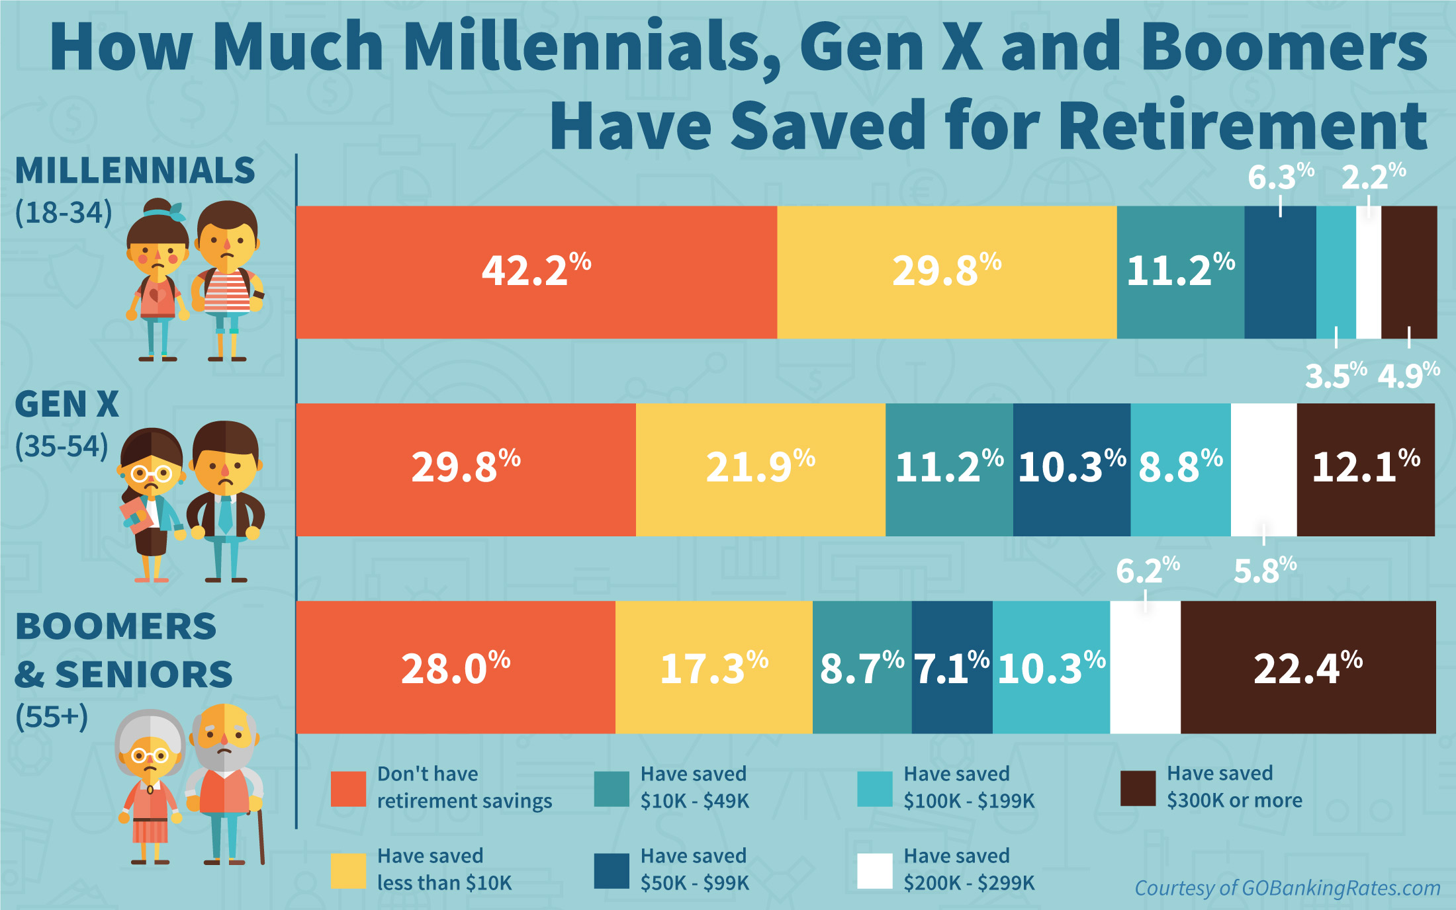

Slide 7
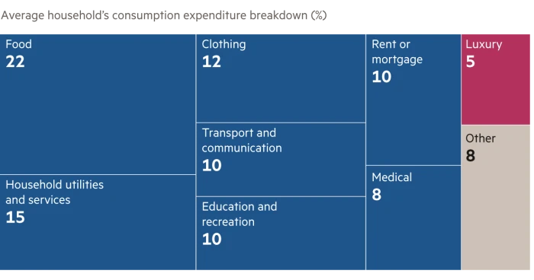
1. Identify two motives for consumer spending. [2]
Why do people spend money?

Slide 8

1. Why do consumers spend money?
to satisfy needs (e.g food, shelter)
to satisfy wants (e.g. luxury goods)
fear of future price rises
to gain satisfaction from that consumption

Slide 9
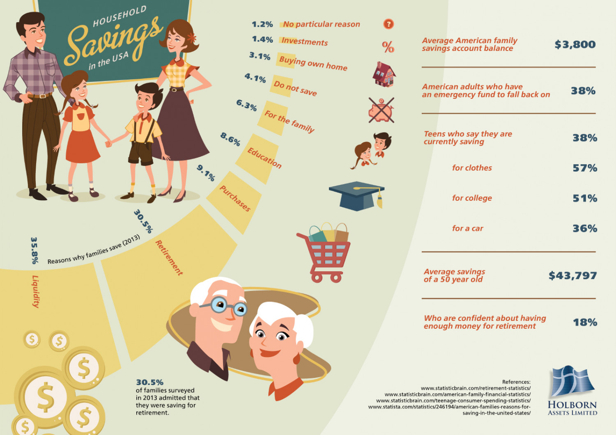

Slide 10

2. Why do households save money?
to gain interest (return on saving)
for the future (e.g. for unexpected events, save for pensions)
to purchase expensive items (e.g. cars, houses, furniture)
for children’s education

Slide 11
Why do people spend and save?
Why do some people spend or save more than others?
  Disposable income
Exercise: Factors that affect consumer expenditure and saving

Slide 12




Why do households sometimes spend more and sometimes less?

Slide 13
Factors that affect the level of consumers expenditure:
real disposable income
wealth 财富
(cash, savings, stocks, houses ...)
consumer confidence
消费者信心
interest rate
实际可支配收入

Slide 14
Why do people spend and save?
Why do some people spend or save more than others?
  Disposable income
Exercise: Factors that affect consumer expenditure and saving

Slide 15

Households usually can’t spend all of their income.
Why not?

Slide 16
income = wages
+ dividends 股息
+ interest 利息 etc.
disposable income
real disposable income
可支配收入
实际可支配收入
income taxes
所得税
and other deductions 扣除
inflation
通货膨胀

Slide 17
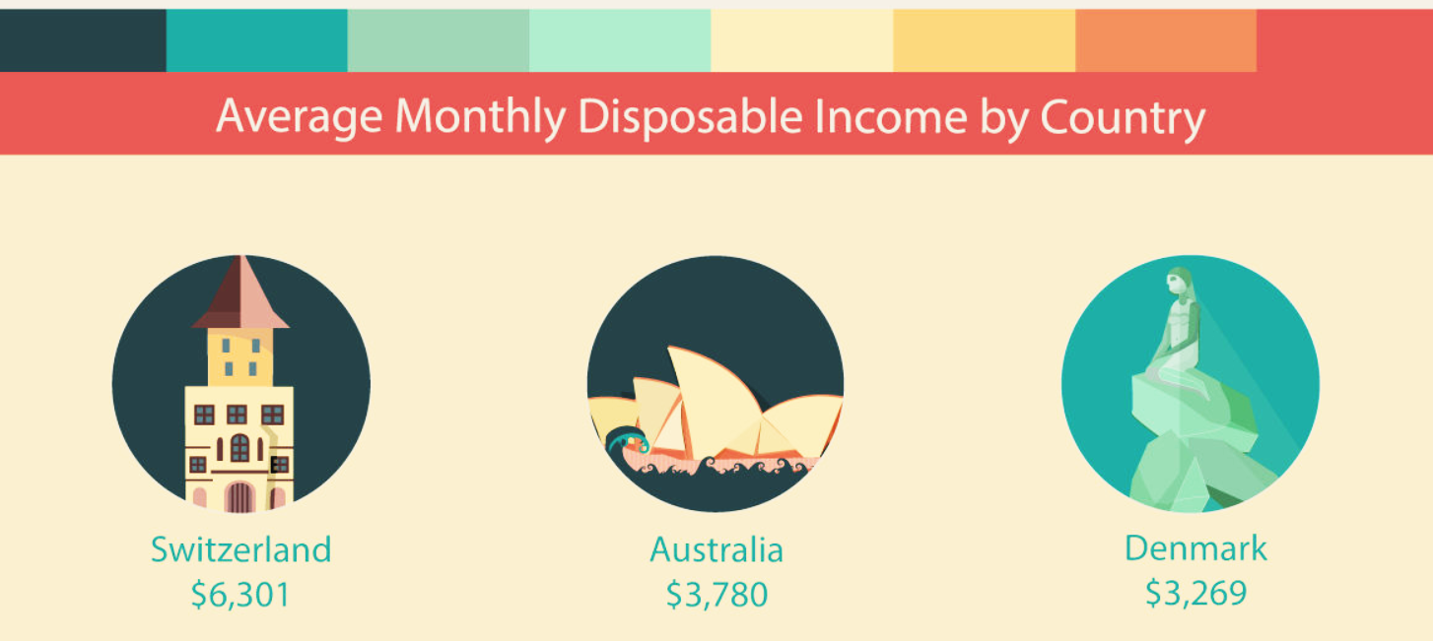
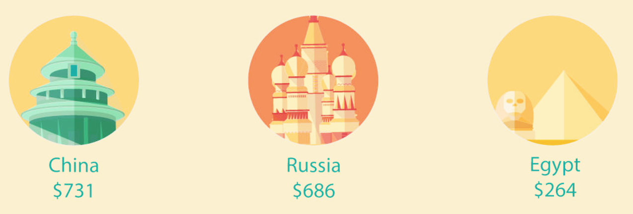
How much disposable income do people have per month?

Slide 19
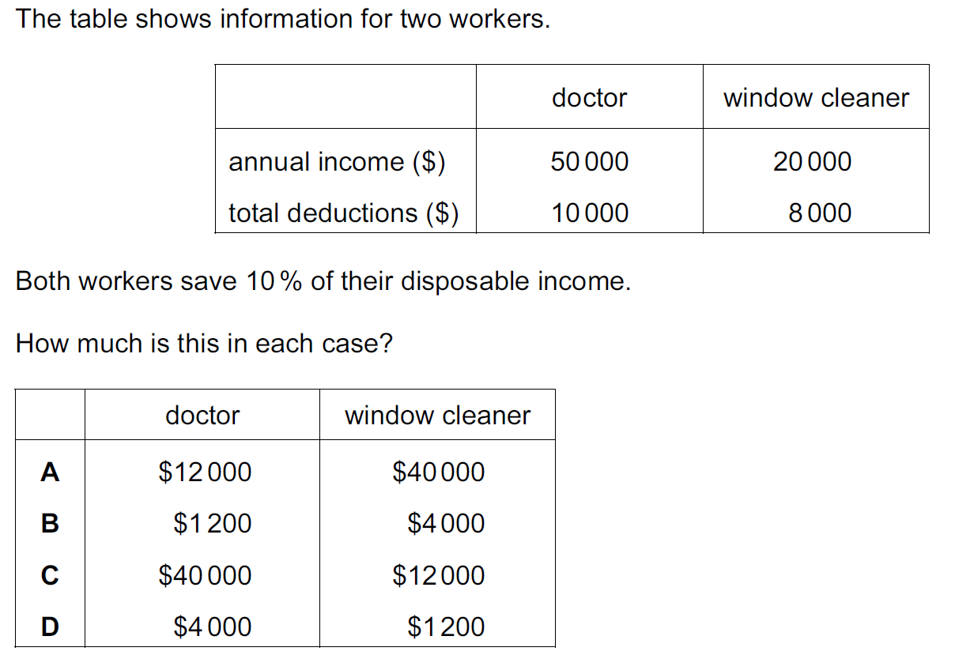

Slide 20
Why do people spend and save?
Why do some people spend or save more than others?
  Disposable income
Exercise: Factors that affect consumer expenditure and saving

Slide 21
How do the following factors affect consumption and saving?
Consumption
Saving
A belief that the price of goods will rise in the future.
A fall in the interest rate paid by the country’s banks
A fear that income will fall in the future.
A rise in the individual’s wish to enjoy higher consumption immediately.

Slide 22

Real income
Spending
Saving
Borrowing
Why?
Rising real incomes make people better off.

Slide 23

Wealth
Spending
Saving
Borrowing
Why?
If people feel wealthy the more they can spend and borrow with confidence

Slide 24

Interest rates
Spending
Saving
Borrowing
Why?
Borrowing more expensive, saving more attractive

Slide 25
Availability of saving schemes
Spending
Saving
Borrowing
Why?
More and better ways of saving and earning interest can encourage saving.

Slide 26
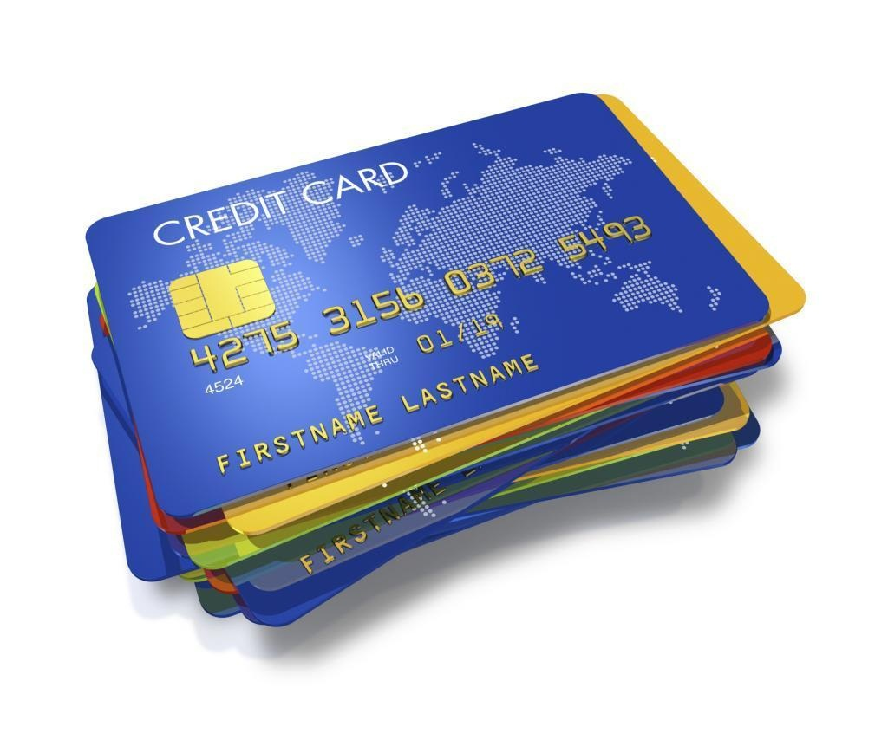
Availability of credit
Spending
Saving
Borrowing
Why?
Cheap, widely available credit cards and loans
encourage people to increase their debt.

Slide 27
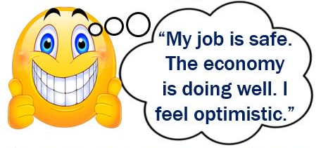
Consumer confidence
Spending
Saving
Borrowing
Why?
People increase spending if they believe
economic conditions are improving.

Slide 28

Direct tax
Spending
Saving
Borrowing
Why?
(1.) Less confident of being able to repay. Borrowing ⬇
(2.) Some people borrow to maintain spending. Borrowing ⬆

Slide 29
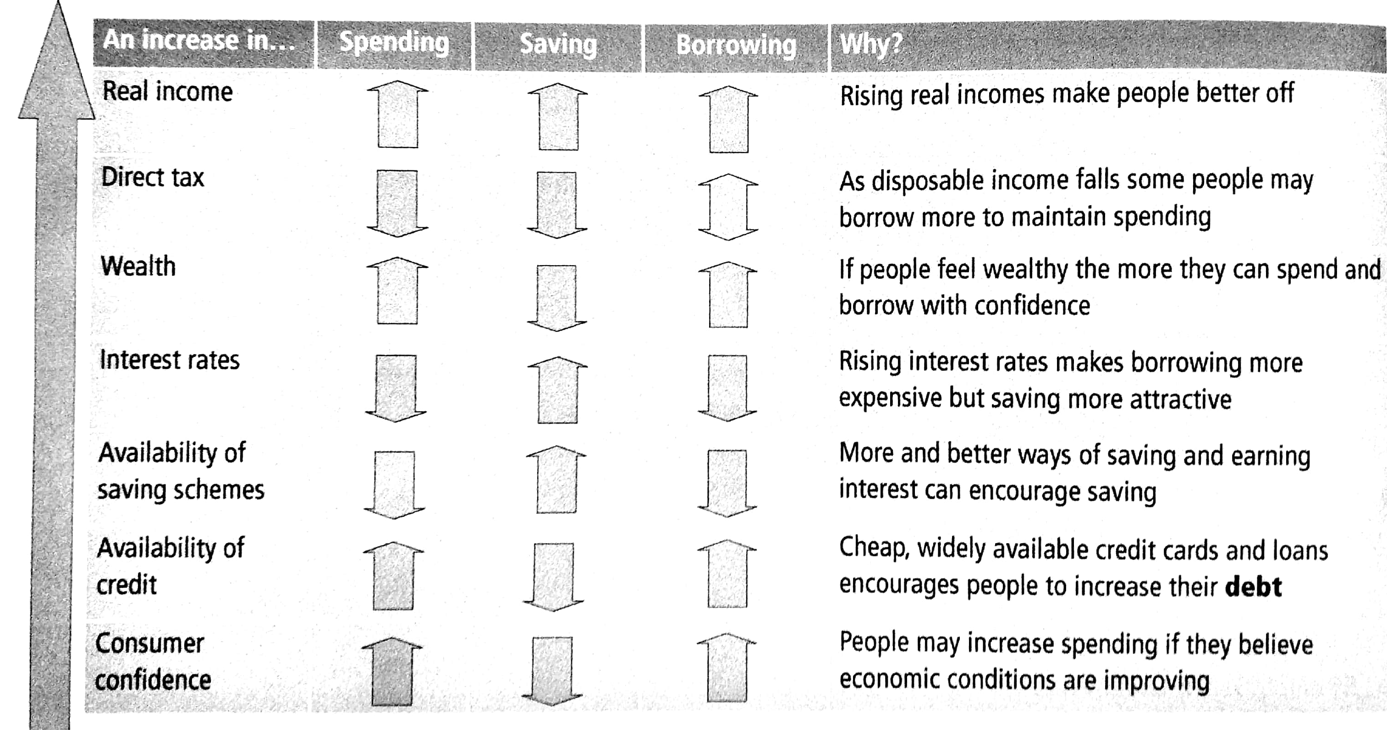
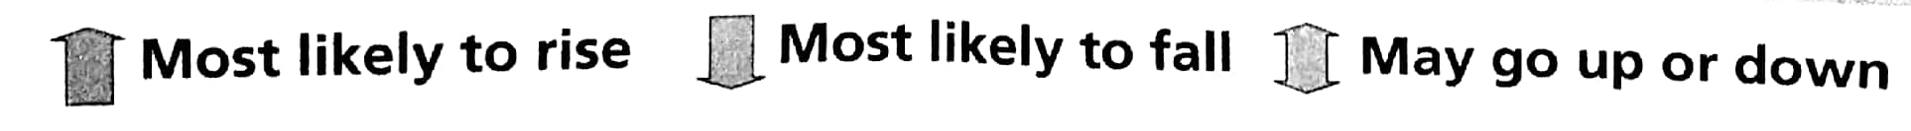

Slide 30
1. What would encourage a rise in spending but not a rise in saving?
得分率
32%
✓
A. easier credit facilities (信贷便利)
B. more people working
C. rising interest rates
D. rising standards of living

Slide 31
2. Nazmin Uddin works in a local office as a secretary three days a week. She lives with her parents in a small apartment. Meer Ali owns a successful fitness centre that employs about twenty people and lives in a large house.
Which is likely to be true?
得分率
46%
A. Nazmin spends a smaller proportion of her income than Meer.
B. Nazmin saves most of her income.
C. Nazmin would find it easier than Meer to borrow money.
D. Nazmin has a lower disposable income than Meer.
✓

Slide 32
3. Which group is likely to save the largest proportion of its income?
得分率
46%
✓
A. employed workers
B. retired people
C. school students
D. unemployed workers

Slide 33
4. Banks accept _______ of money and savings from their customers and make _____ from this money.
得分率
48%
A. deposits; deposits
B. deposits; loans
C. loans; deposits
D. loans; loans
✓

Slide 34
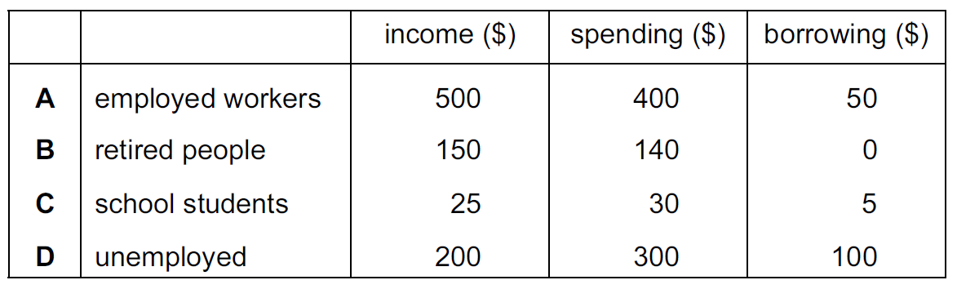
5. The table shows the weekly values of certain items for the average person in each group.
Which group saves the most on average?
得分率
62%

Slide 35
6. What might cause a rise in the proportion of income that a person saves?
得分率
58%
A. a fall in interest rates
B. a fall in population
C. a fall in real incomes
D. a fall in the income tax rate
✓

